Slide 1
CS 2433: C/C++ Programming Tuesday and Thursday 2:00pm to 3:15pm MSCS 108
Oklahoma State University
CS 2433: C/C++ Programming

Slide 2
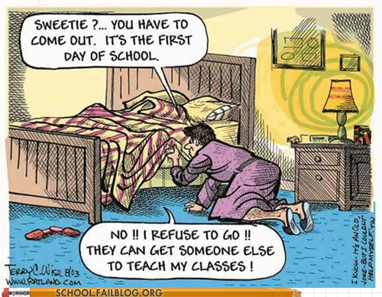
Oklahoma State University
CS 2433: C/C++ Programming

Slide 3
“College is a place where the professor’s lecture notes go straight to the students’ lecture notes, without passing through the brains of either” – Mark Twain
“Some people talk in their sleep. Lecturers talk while other people sleep” – Albert Camus
Oklahoma State University
CS 2433: C/C++ Programming

Slide 4
To break the ice
What are your expectations for this class?
Why are you taking it?
Programming level: CS1, CS2, seniors
What are instructor expectations?
Oklahoma State University
CS 2433: C/C++ Programming

Slide 5
Course Staff
Richard Churchill
Instructor
Office: MSCS 536
Richard.l.Churchill@okstate.edu
Hours: Monday, Wednesday and Thursday, 3:30 to 5:00 PM
Abhishek Yanduru
T.A.
Office: ?
yanduru@okstatemail.okstate.edu
Hours: TBD, but unavailable on Mondays.
Oklahoma State University
CS 2433: C/C++ Programming

Slide 6
Course Webpage
https://online.okstate.edu
Oklahoma State University
CS 2433: C/C++ Programming

Slide 7
Agenda
Syllabus
Schedule
Administrative stuff
Oklahoma State University
CS 2433: C/C++ Programming

Slide 8
Lecture Room
MSCS 108
Tuesdays and Thursdays 2pm to 3:15pm
Oklahoma State University
CS 2433: C/C++ Programming

Slide 9
Course Objectives
Learn C/C++
Write good code
Use good programming style
Given a programming problem, design and implement a solution
Easy and short programs at the beginning; will get harder and longer
Oklahoma State University
CS 2433: C/C++ Programming

Slide 10
Online Textbook (required)
http://okstatespr14.zyante.com/
Animation and interactive
Oklahoma State University
CS 2433: C/C++ Programming

Slide 11
Subscribe to Zyante
Click subscribe
Enter name, okstate e-mail address, and access-code
Cheaper than regular textbooks
Oklahoma State University
CS 2433: C/C++ Programming

Slide 12
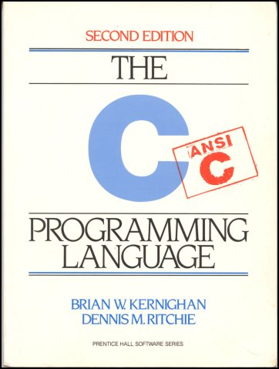
Textbooks (optional but recommended)
Oklahoma State University
CS 2433: C/C++ Programming

Slide 13
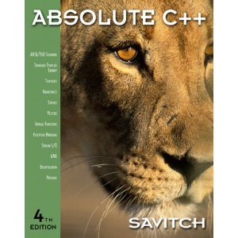
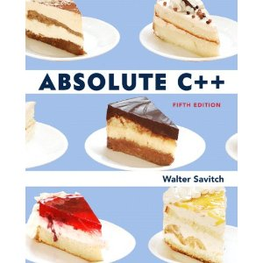
Textbooks (optional)
Oklahoma State University
CS 2433: C/C++ Programming

Slide 14
Assignments
Zyante’s Activities | 5%
In-class Participation | 5%
Programming Assignments (13) Note: Not all homeworks have the same weight | 70%
Exam 1 (Thursday February 20) | 5%
Exam 2 (Thursday April 10) | 5%
Final Exam Tuesday May 6, 2:00pm – 3:50pm | 10%
Oklahoma State University
CS 2433: C/C++ Programming

Slide 15
Grades
A: >= 90%
B: >= 80%
C: >= 70%
D: >= 60%
F: < 60%
No curve; everybody can get an A or F
Oklahoma State University
CS 2433: C/C++ Programming

Slide 16
Zyante
Animations/Activities
Questions at the end of each chapter and subchapter
Online
Oklahoma State University
CS 2433: C/C++ Programming

Slide 17
In-Class Participation
Attendance
Submitting in-class activities
Code has to solve problem
Okay if not complete
Oklahoma State University
CS 2433: C/C++ Programming

Slide 18
Course Website
https://online.okstate.edu
All course materials are available
Syllabus, schedule
Lecture notes, code examples
Homeworks, solutions
Grades
Discussion forum
Oklahoma State University
CS 2433: C/C++ Programming

Slide 19
Student Expectations
Attend class and participate
Read lecture notes, code examples, and textbook before and after class
Ask for help and questions
Don’t be shy!
Complete homework assignments on time
Check e-mail and course website at least once a day
Oklahoma State University
CS 2433: C/C++ Programming

Slide 20
Student Expectations
Enjoy the course and enjoy learning a new programming language
Have fun!
Oklahoma State University
CS 2433: C/C++ Programming

Slide 21
Instructor Expectations
Come to class prepared
Be available for help
Send e-mail or stop by during office hours or by appointment
Open-door policy
Provide a good classroom environment for learning
Open to suggestions and feedback
Oklahoma State University
CS 2433: C/C++ Programming

Slide 22
Policies
Programming course
~6 hours per week, depending on programming knowledge
E-mail
Add [CS 2433] to subject line
E-mail … well … we’re working that out.
We will try to respond within 24 hours
Faster response time usually during the day
Oklahoma State University
CS 2433: C/C++ Programming

Slide 23
Policies
You can use electronic devices (and the computer in front of you)
Only for legitimate classroom purposes
Youtube, FB, Twitter, e-mail, IM, etc… are NOT legitimate classroom activities
Do NOT distract the class or your classmates
Oklahoma State University
CS 2433: C/C++ Programming

Slide 24
Policies
Attendance not required (meaning you won’t fail if you don’t attend)
Highly recommended
Part of your overall grade
Late homework
50% penalty if one day late
Example: You received 5/10 for Homework1 and submitted one day late: final grade = 2.5/10
Oklahoma State University
CS 2433: C/C++ Programming

Slide 25
Policies
Questions about your grades?
Contact course staff within ONE week of receiving the grade
No make-up exam
Unless provable emergency
Contact course staff if you will miss an exam
No incomplete
Unless provable emergency
Oklahoma State University
CS 2433: C/C++ Programming

Slide 26
Homework Policy
You have to do your own work
Discussion of homeworks is allowed and encouraged
Write your own code
No copy and paste
Oklahoma State University
CS 2433: C/C++ Programming

Slide 27
Course Format
Lecture notes
Code examples
Hands-on activities
Ask questions!
You are expected to have completed the assigned readings before class
Oklahoma State University
CS 2433: C/C++ Programming

Slide 28
Homework Format
One homework roughly every week
If exam, no homework due on that week
Due on Fridays at 11:59pm
Start EARLY!
Be sure to submit your source code (.c or .cpp files; equivalent to .java files)
Oklahoma State University
CS 2433: C/C++ Programming

Slide 29
Questions?
Oklahoma State University
CS 2433: C/C++ Programming

Slide 30
Handouts
Go over syllabus
Go over schedule
Assigned reading to be completed before the lecture
Activate O-key
Go over course website
Go over Zyante site
Oklahoma State University
CS 2433: C/C++ Programming

Slide 31
Activity
Roll call
Know at least one other person in class
Oklahoma State University
CS 2433: C/C++ Programming

Slide 32
Homework0 (2% of your grade)
Meet with me in my office
Office hour or appointment
Submit picture, name, class year
Helps me remember your name throughout the semester
Oklahoma State University
CS 2433: C/C++ Programming

Slide 33
Next Time
Read Chapter 1.1, 1.2, 1.3
How to program, use CSx, handin homeworks
Overview of C and C++
Activate your O-key
Oklahoma State University
CS 2433: C/C++ Programming

Slide 34
http://oc.okstate.edu
Go Pokes!
Oklahoma State University
CS 2433: C/C++ Programming

